Slide 1
SUPERVISED QUADTREES:
a new metalearner for
local data science
LEVI JOHN WOLF
levi.john.wolf@bristol.ac.uk

Slide 2
CLUSTERING REGRESSION
GEOGRAPHICAL CLUSTER-REG
UNDERSTANDING QUADTREES
APPLYING QUADTREE REGRESSION
THE SUPERVISED QUADTREE

Slide 3
CLUSTERING REGRESSION
jointly solving clustering and regression
GEOGRAPHICAL CLUSTER-REG
UNDERSTANDING QUADTREES
APPLYING QUADTREE REGRESSION
THE SUPERVISED QUADTREE

Slide 4

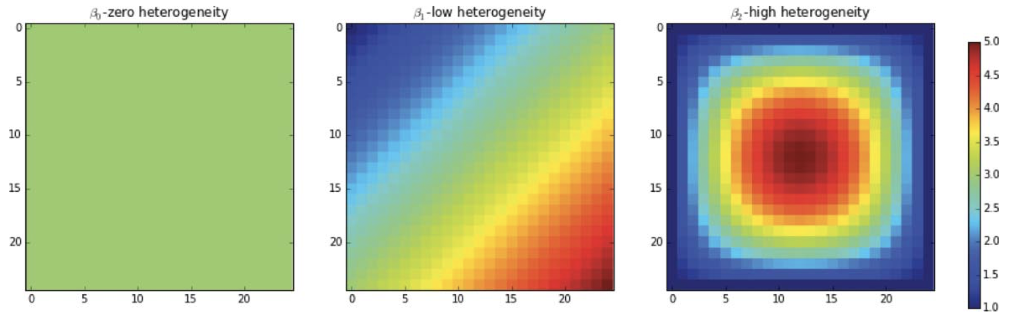
WHAT IS CLUSTERING REGRESSION

Slide 5
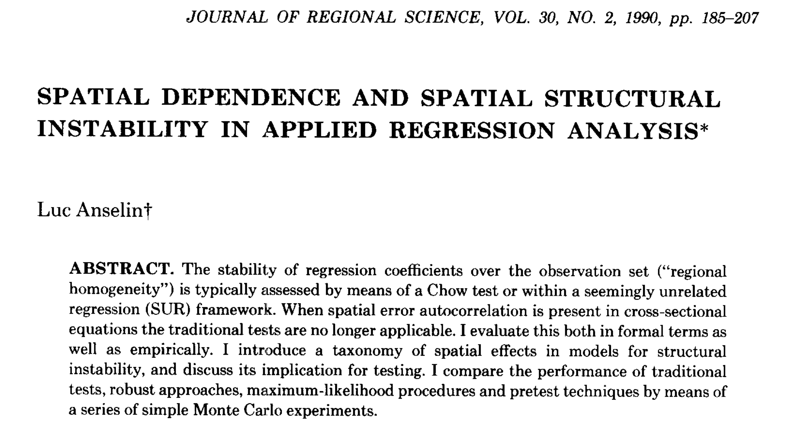
WHAT IS CLUSTERING REGRESSION

Slide 6
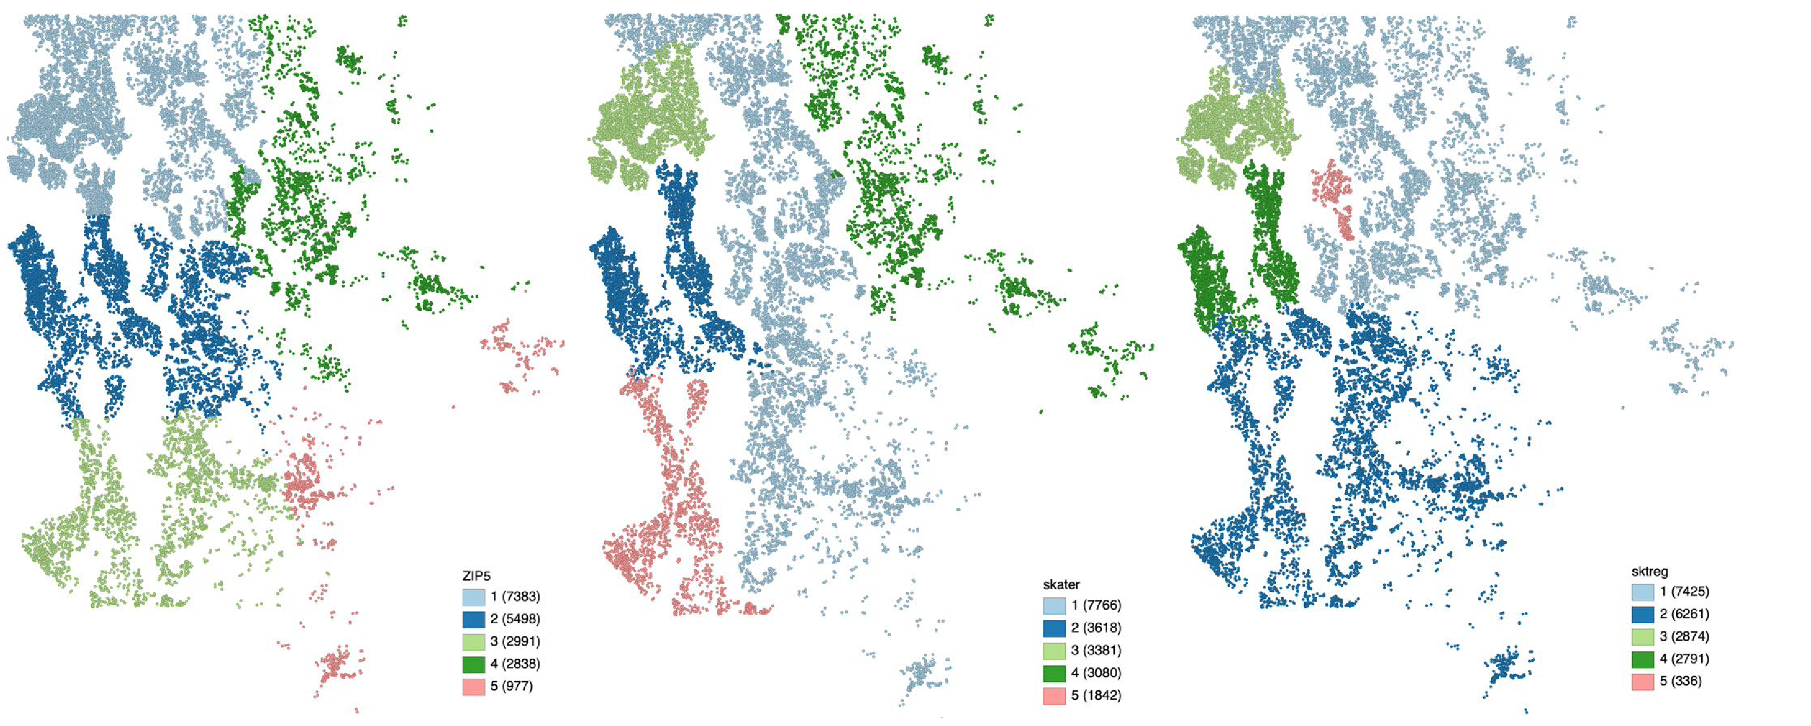
ZIP CODE
WHAT IS CLUSTERING REGRESSION

Slide 7
SPATIAL CLUSTER
ZIP CODE
WHAT IS CLUSTERING REGRESSION

Slide 8
Späth (1979)’s three-stage process
- CLUSTER: find clusters in the data
- ESTIMATE: fit the model using clusters as a feature
- REFINE: flip poorly-fit observations to a different cluster
Heuristic (i.e. not optimal), slow+computationally intensive, likelihood-dependent, even in the
seriously improved spatial variant provided by Sugasawa and Murakami (2021)
No guarantee of recovering the original classes
BEFORE THE SUPERVISED QUADTREE

Slide 9
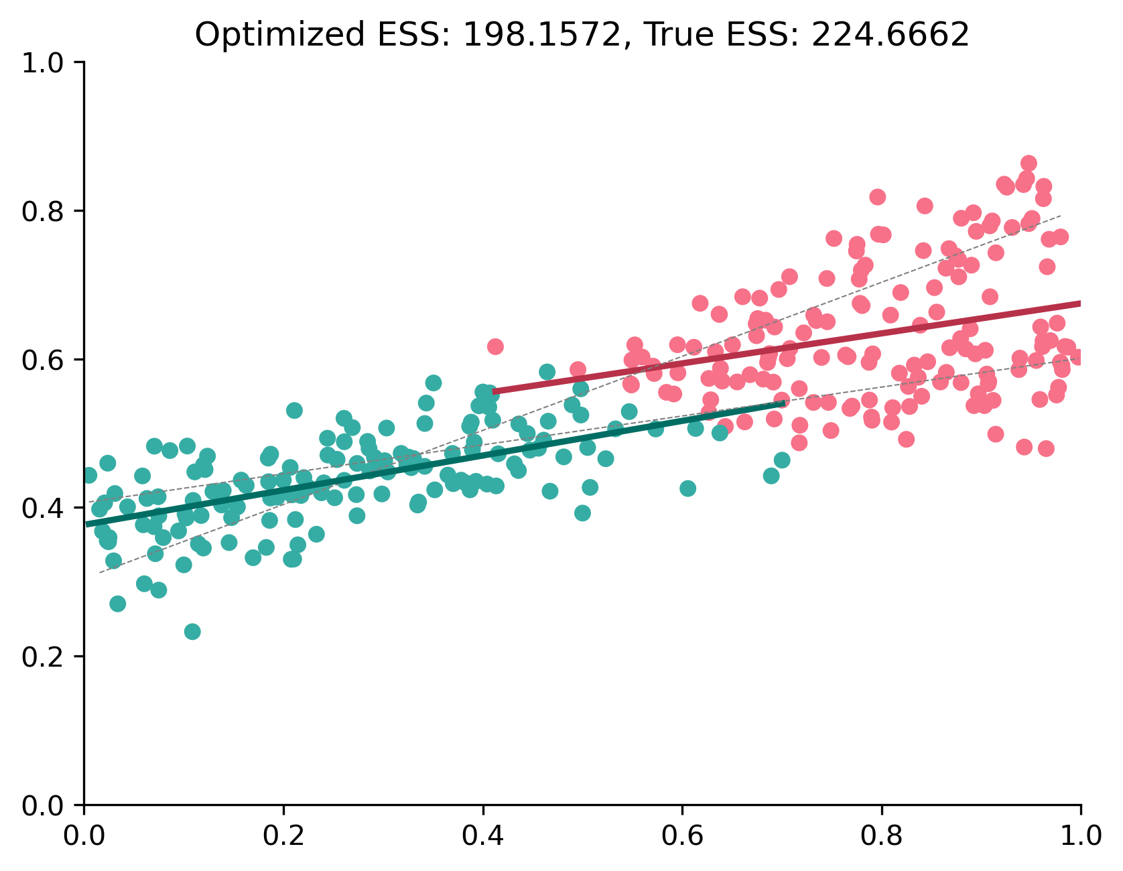
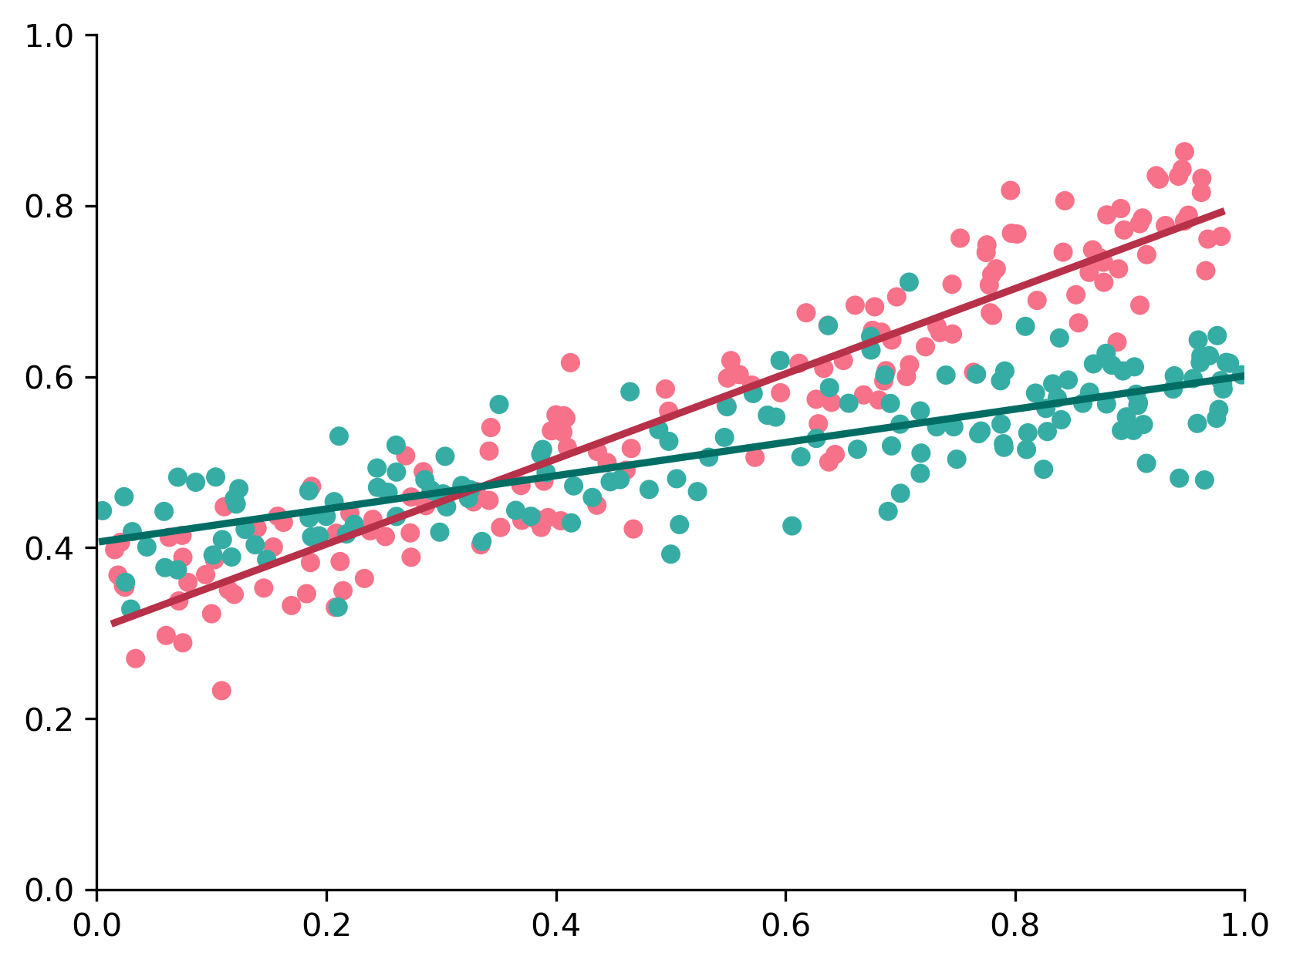
TRUE CLUSTERS
SPÄTH (1979) ITERATIVE CLUSTERING

Slide 10
SPÄTH (1979) ITERATIVE CLUSTERING

Slide 11
OPTIMAL-ish BREAK
SPÄTH (1979) ITERATIVE CLUSTERING

Slide 12
CLUSTERING REGRESSION
jointly solving clustering and regression
GEOGRAPHICAL CLUSTER-REG
jointly solving clustering and regression
UNDERSTANDING QUADTREES
APPLYING QUADTREE REGRESSION
THE SUPERVISED QUADTREE

Slide 13
Späth (1979)’s three-stage process
- CLUSTER: find clusters in the data
- ESTIMATE: fit the model using clusters as a feature
- REFINE: flip poorly-fit observations to a different cluster
Heuristic (i.e. not optimal), slow+computationally intensive, likelihood-dependent, even in the
seriously improved spatial variant provided by Sugasawa and Murakami (2021)
No guarantee of recovering the original classes
Anselin & Amaral (2023)
- COMBINE: Combine spatial and feature similarity
- SPAN: compute a MST over the combined affinity matrix
- PRUNE: remove MST links to create clusters according to (SSR – (SSR_{a} + SSR_{b}))
Spends degrees of freedom judiciously; n-clusters x n-features interactions
Remains fully within the standard Wald/LRT/Chow-based testing framework
MSTs can be quite unstable over Cross-validation
Requires prior knowledge of the deepest number of clusters
Avoids overfitting, since splits could be made below j
BEFORE THE SUPERVISED QUADTREE

Slide 14
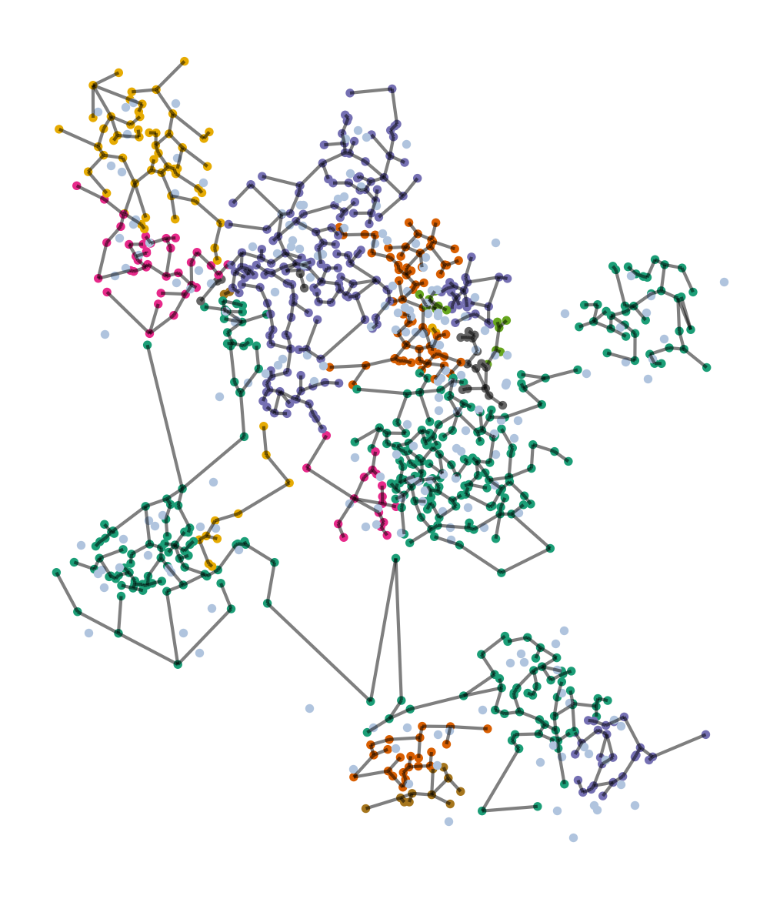
SKATER REGRESSION
Notes:
Maybe put a little schematic here showing the different regression lines by cluster.

Slide 15
each cluster gets
one regression
SKATER REGRESSION
Notes:
Maybe put a little schematic here showing the different regression lines by cluster.

Slide 16
each cluster gets
one regression
clusters are regions that improve model fit
SKATER REGRESSION
Notes:
Maybe put a little schematic here showing the different regression lines by cluster.

Slide 17
MST Blues
- finnicky in CV
- no total order
- can’t do out of sample
SKATER REGRESSION

Slide 18
MST Blues
- finnicky in CV
- no total order
- can’t do out of sample
MST CHANGES DRAMATICALLY UNDER CV

Slide 19
Distant in some splits, neighbors in others!
MST Blues
- finnicky in CV
- no total order
- can’t do out of sample
TREE ADJACENCY IS NOT FULL SIMILARITY

Slide 20
To whom should this connect?
MST Blues
- finnicky in CV
- no total order
- can’t do out of sample
ITERATIVE MST IS NOT FULL MST

Slide 21
CLUSTERING REGRESSION
jointly solving clustering and regression
GEOGRAPHICAL CLUSTER-REG
jointly solving clustering and regression
UNDERSTANDING QUADTREES
spatial splits for spatial fits
APPLYING QUADTREE REGRESSION
THE SUPERVISED QUADTREE

Slide 22
QUADTREES IN IMAGE COMPRESSION

Slide 23
SPEND DETAIL WHERE ITS NEEDED MOST

Slide 24
0. INITIALIZE
SPLIT
2. PRUNE
3. FINALIZE
Fit a global model across all observations
Recursively find quadrants where local is improves on global
After, “roll up” useless leaf:feature interactions depth-first
Interpret the pruned global model as you need
THE SUPERVISED QUADTREE

Slide 25
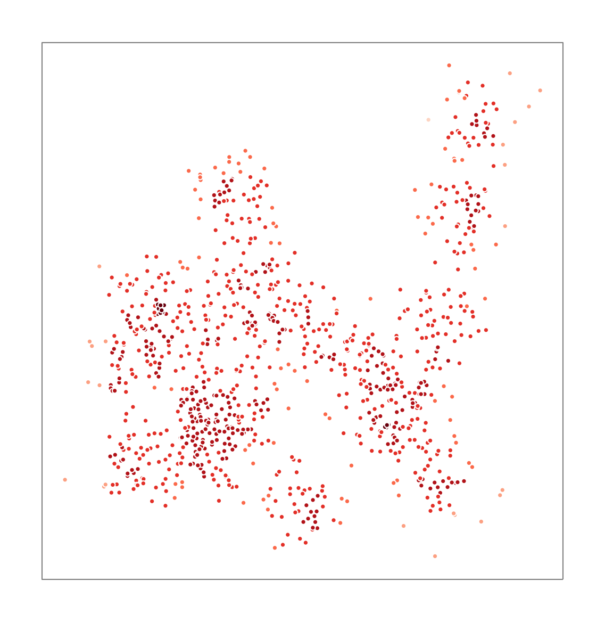
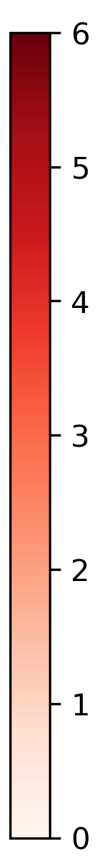
0
WALK DOWN THE DEPTH LADDER

Slide 26
c | x₁
1 | x₁₁
1 | x₁₂
1 | x₁₃
1 | x₁₄
1 | x₁₅
… | …
1 | x_{1n}
0
WALK DOWN THE DEPTH LADDER

Slide 27
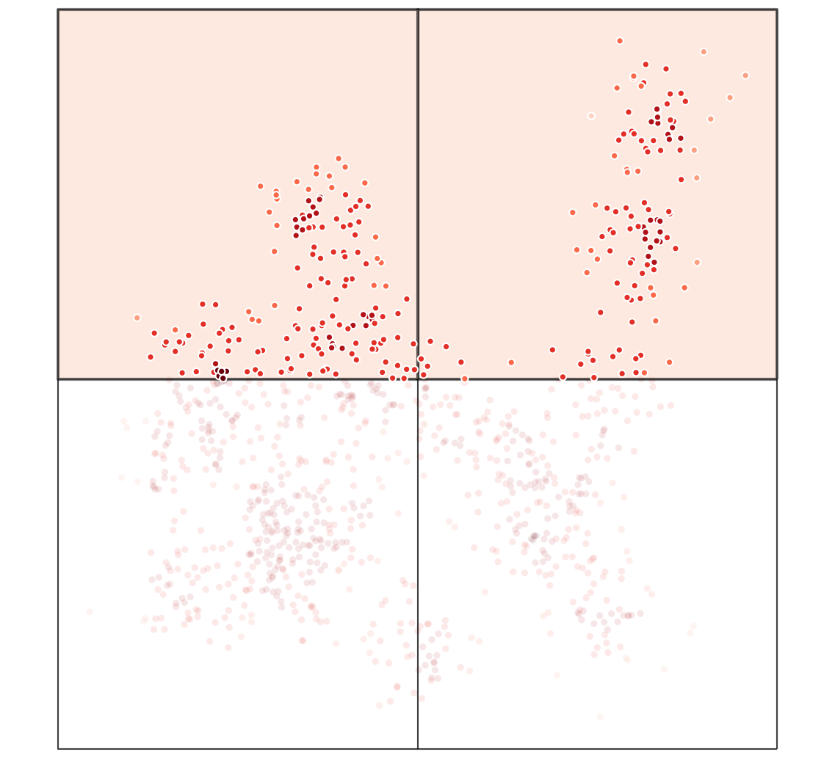
2
1
4
3
WALK DOWN THE DEPTH LADDER
Notes:
Inside of the parent square, can we make a better prediction if we introduce a fixed effect x interaction terms for the child? If so, do so.

Slide 28
2
1
c | c₁ | c₂
0 | 1 | 0
0 | 1 | 0
0 | 0 | 1
0 | 0 | 1
1 | 0 | 0
… | … | …
1 | 0 | 0
x₁:c | x₁:c₁ | x₁:c₂
0 | x₁₁ | 0
0 | x₁₂ | 0
0 | 0 | x₁₃
0 | 0 | x₁₄
x₁₅ | 0 | 0
… | … | …
x_{1n} | 0 | 0
4
3
WALK DOWN THE DEPTH LADDER
Notes:
Inside of the parent square, can we make a better prediction if we introduce a fixed effect x interaction terms for the child? If so, do so.

Slide 29
2
1
c | c₁ | c₂
0 | 1 | 0
0 | 1 | 0
0 | 0 | 1
0 | 0 | 1
1 | 0 | 0
… | … | …
1 | 0 | 0
x₁:c | x₁:c₁ | x₁:c₂
0 | x₁₁ | 0
0 | x₁₂ | 0
0 | 0 | x₁₃
0 | 0 | x₁₄
x₁₅ | 0 | 0
… | … | …
x_{1n} | 0 | 0
4
3
WALK DOWN THE DEPTH LADDER
Notes:
Inside of the parent square, can we make a better prediction if we introduce a fixed effect x interaction terms for the child? If so, do so.

Slide 30
2
1
c | c₁ | c₂
0 | 1 | 0
0 | 1 | 0
0 | 0 | 1
0 | 0 | 1
1 | 0 | 0
… | … | …
1 | 0 | 0
x₁:c | x₁:c₁ | x₁:c₂
0 | x₁₁ | 0
0 | x₁₂ | 0
0 | 0 | x₁₃
0 | 0 | x₁₄
x₁₅ | 0 | 0
… | … | …
x_{1n} | 0 | 0
4
3
WALK DOWN THE DEPTH LADDER
Notes:
Inside of the parent square, can we make a better prediction if we introduce a fixed effect x interaction terms for the child? If so, do so.

Slide 31
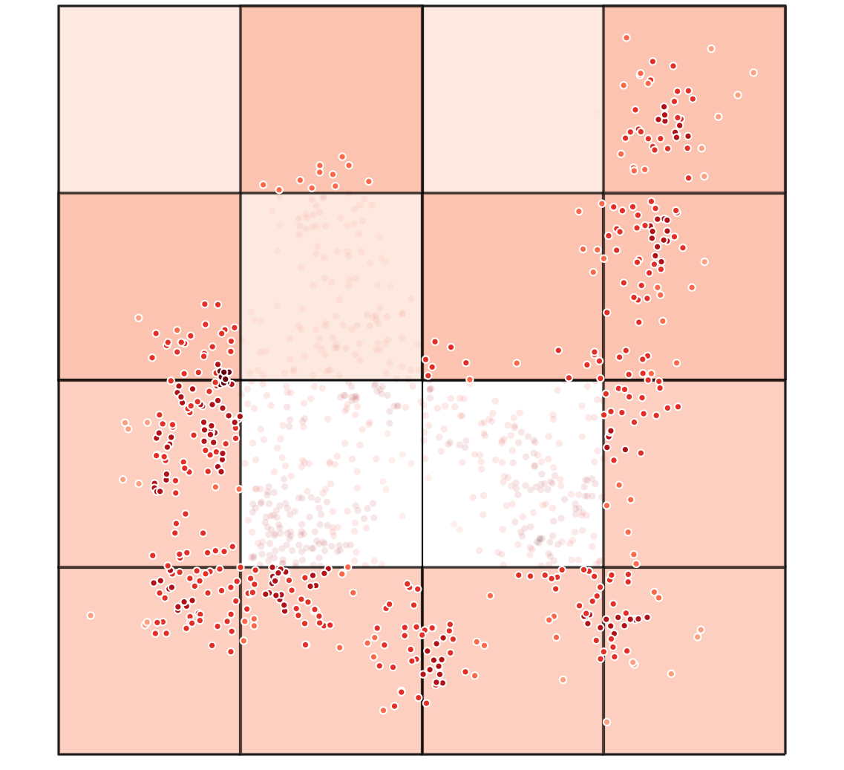
WALK DOWN THE DEPTH LADDER
Notes:
This next level is comparing only against level 2. highlighted, all this data is “used” in the new models at this level.

Slide 32
22
21
12
11
24
23
14
13
42
41
32
31
44
43
34
33
WALK DOWN THE DEPTH LADDER
Notes:
This next level is comparing only against level 2. highlighted, all this data is “used” in the new models at this level.

Slide 33
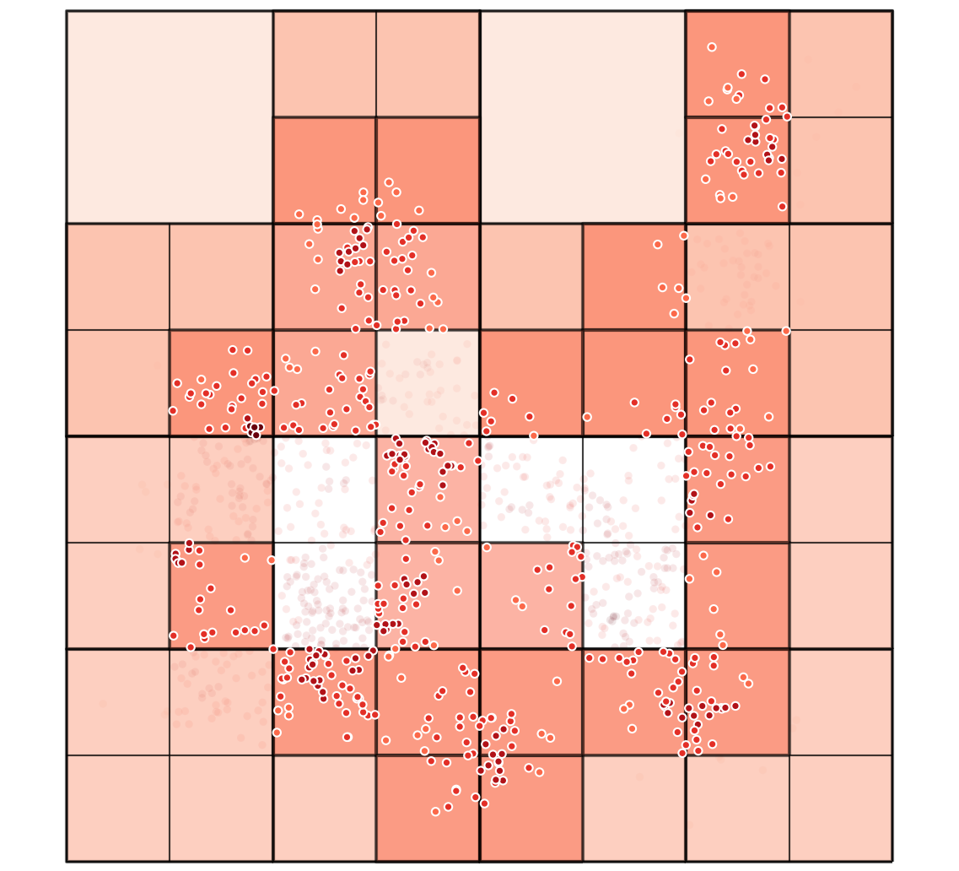
WALK DOWN THE DEPTH LADDER

Slide 34
243
WALK DOWN THE DEPTH LADDER

Slide 35
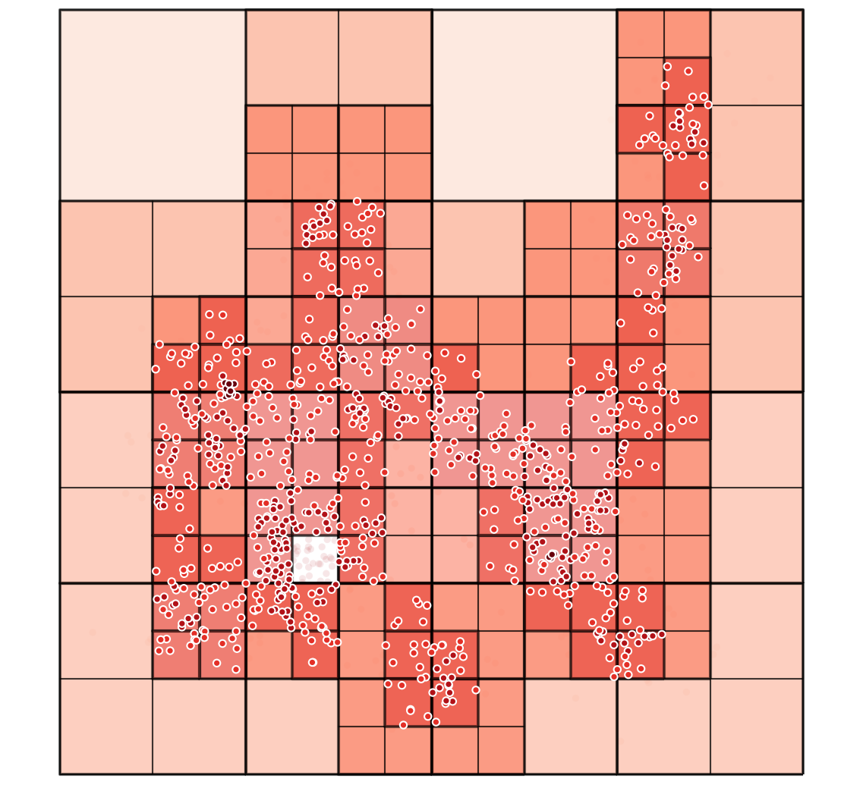
WALK DOWN THE DEPTH LADDER

Slide 36
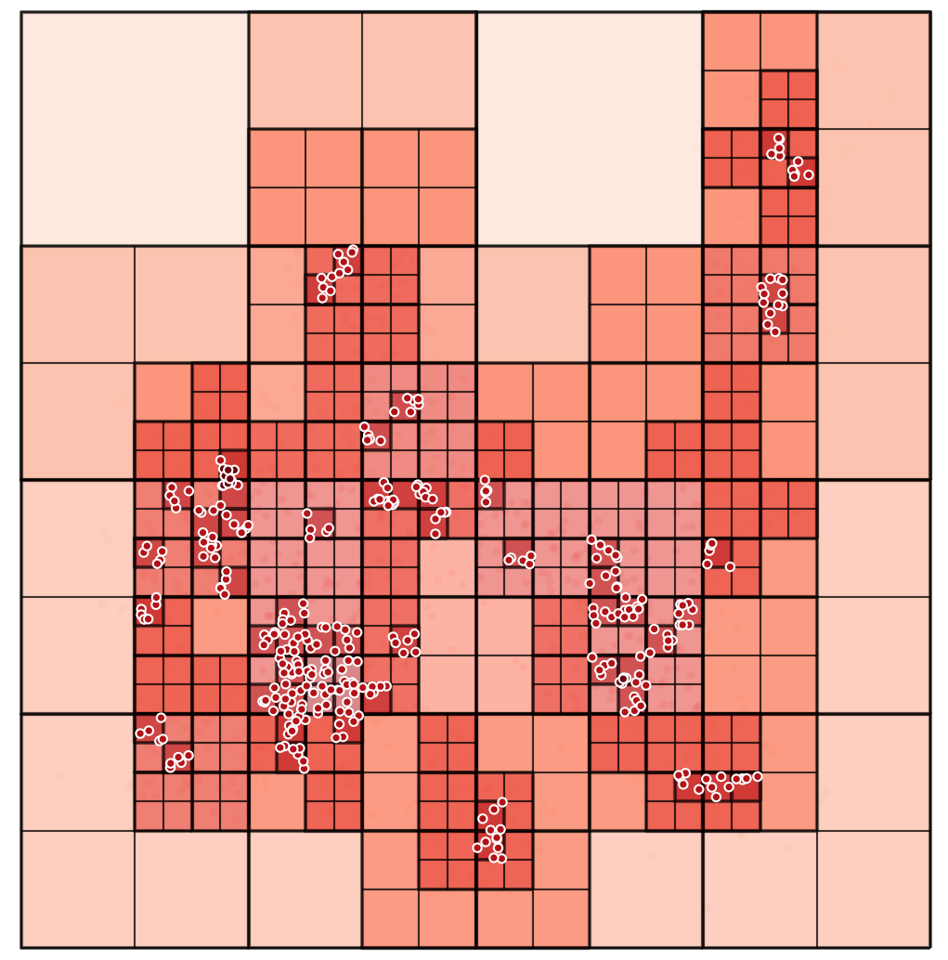
WALK DOWN THE DEPTH LADDER

Slide 37
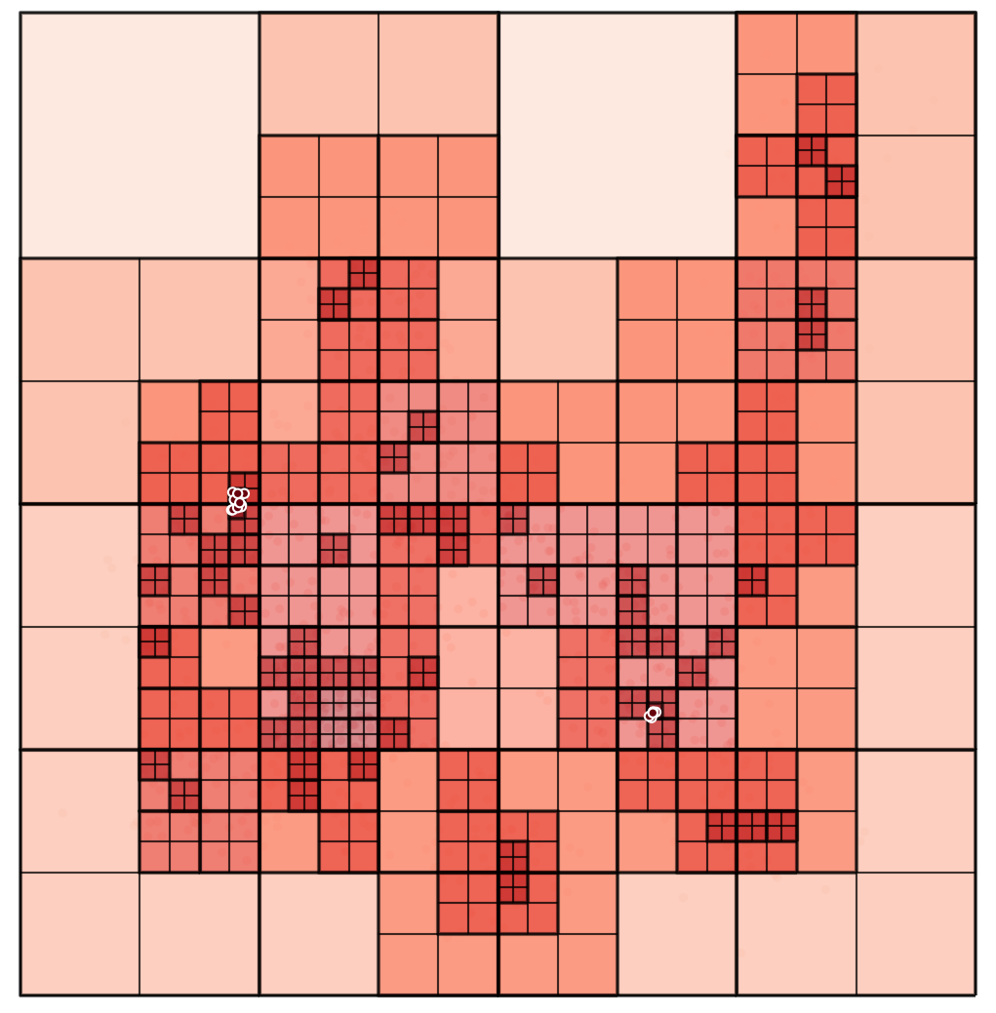
WALK DOWN THE DEPTH LADDER

Slide 38
323414
WALK DOWN THE DEPTH LADDER

Slide 39
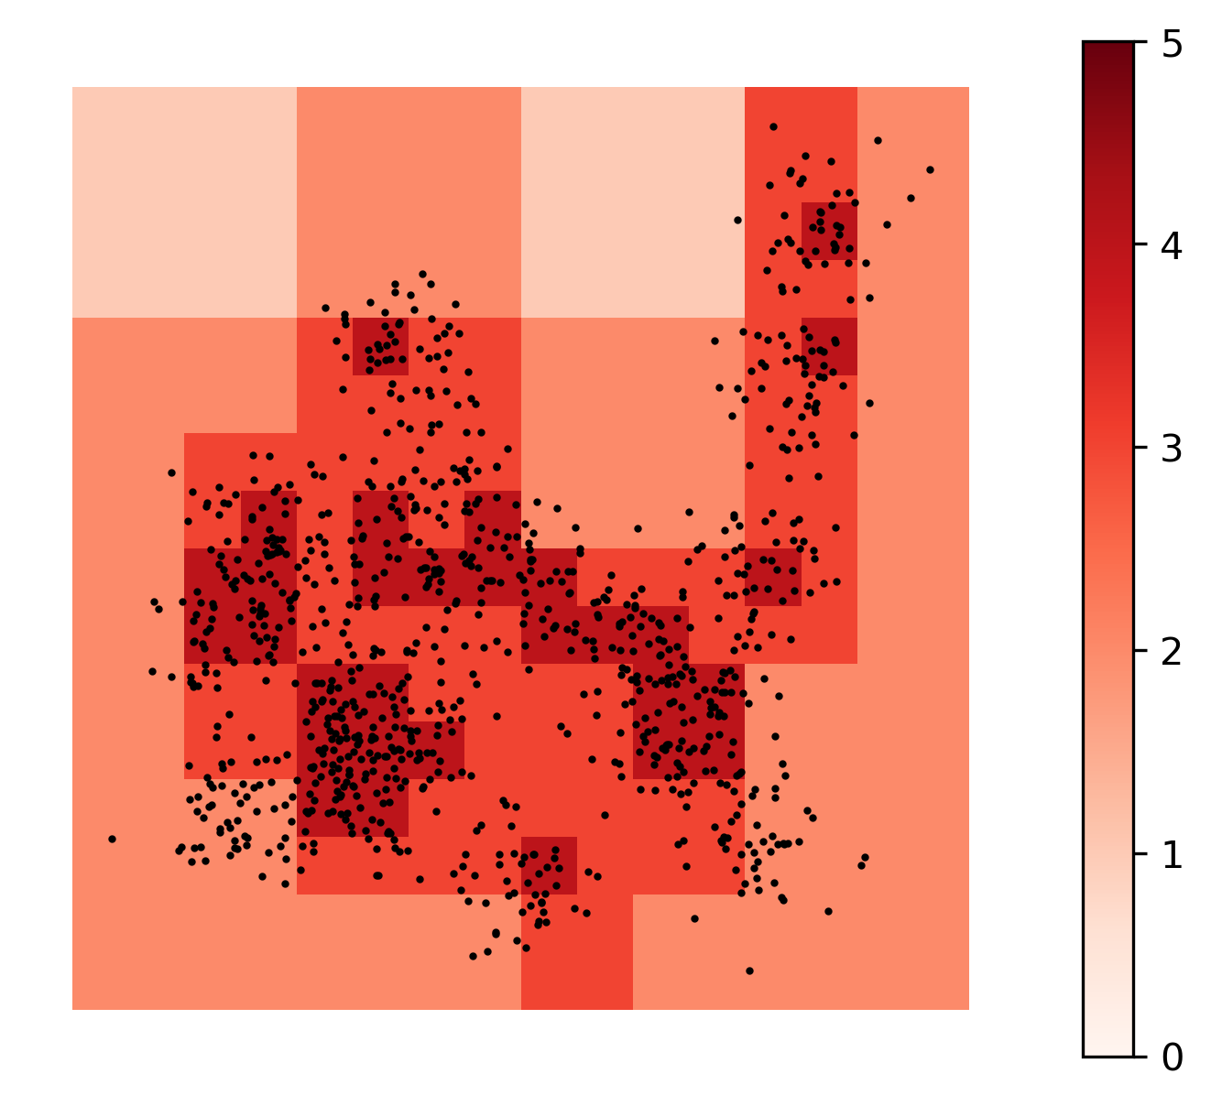
SuperQT
- stable in CV
- totally ordered
- simple out of sample and update
QUADTREES ARE FAIRLY STABLE IN CV

Slide 40
SuperQT
- stable in CV
- totally ordered
- simple out of sample and update
QUADTREES ARE FAIRLY STABLE IN CV

Slide 41
TOTALLY ORDERED
An observation will nest exactly into one cell at any given depth, and fit depth is a function of both fit and density, and big jumps in depth are rare.
QUADTREES ARE FAIRLY STABLE IN CV

Slide 42
OUT-OF-BAG
For interpolating predictions within frame,
we always have a model
Always 2
2 or 21
4112
or
411
QUADTREES ARE FAIRLY STABLE IN CV

Slide 43
OUT-OF-BAG
For interpolating predictions within frame,
we always have a model
For extrapolating predictions outside frame,
we always use model 0.
QUADTREES ARE FAIRLY STABLE IN CV

Slide 44
2
1
OUT-OF-BAG
For interpolating predictions within frame,
we always have a model
For extrapolating predictions outside frame,
we always use model 0.
UPDATING
Treat 0 as a child of some larger frame and prepend all cells with its new index
4
3
QUADTREES ARE FAIRLY STABLE IN CV

Slide 45
2
1
OUT-OF-BAG
For interpolating predictions within frame,
we always have a model
For extrapolating predictions outside frame,
we always use model 0.
UPDATING
Treat 0 as a child of some larger frame and prepend all cells with its new index
4
3
424 updates to 4424
QUADTREES ARE FAIRLY STABLE IN CV

Slide 46
0. INITIALIZE: enqueue a root cell that predicts y ~ X, the “global” model
1. SPLIT: pop the first cell from our queue and split it into four. For each split:
1-1. fit a submodel predicting only outcomes in that cell using data in that cell.
1-2. update predictions for the whole map
1-3. if predictions are significantly better, return the split to the queue & go to 1,
otherwise assign all observations in that split the parent’s label & discard the split.
2. PRUNE: fit a model with all current feature X label interactions (one hot).
2-1. if all terms are significant, go to 3,
otherwise find the deepest non-significant term, d*
2-2. for all non-significant terms at d*
2-2-1. merge the non-significant term into its parent leaf’s term
2-2-2. remove the non-significant term itself and go to 2-1.
3. FINALIZE: Fit a final model on the final design matrix from 2.
THE SUPERVISED QUADTREE

Slide 47
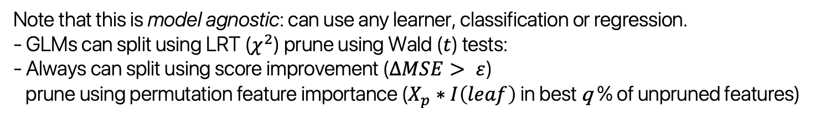
0. INITIALIZE: enqueue a root cell that predicts y ~ X, the “global” model
1. SPLIT: pop the first cell from our queue and split it into four. For each split:
1-1. fit a submodel predicting only outcomes in that cell using data in that cell.
1-2. update predictions for the whole map
1-3. if predictions are significantly better, return the split to the queue & go to 1,
otherwise assign all observations in that split the parent’s label & discard the split.
2. PRUNE: fit a model with all current feature X label interactions (one hot).
2-1. if all terms are significant, go to 3,
otherwise find the deepest non-significant term, d*
2-2. for all non-significant terms at d*
2-2-1. merge the non-significant term into its parent leaf’s term
2-2-2. remove the non-significant term itself and go to 2-1.
3. FINALIZE: Fit a final model on the final design matrix from 2.
Note that this is model agnostic: can use any learner, classification or regression.
- GLMs can split using LRT ($χ^{2}$) prune using Wald ($t$) tests:
- Always can split using score improvement ($∆MSE> ε$)
prune using permutation feature importance ($X_{p}∗I\left(leaf\right)$ in best q % of unpruned features)
THE SUPERVISED QUADTREE

Slide 48
CLUSTERING REGRESSION
jointly solving clustering and regression
GEOGRAPHICAL CLUSTER-REG
jointly solving clustering and regression
UNDERSTANDING QUADTREES
spatial splits for spatial fits
APPLYING QUADTREE REGRESSION
model comparison & basic metrics
THE SUPERVISED QUADTREE

Slide 49
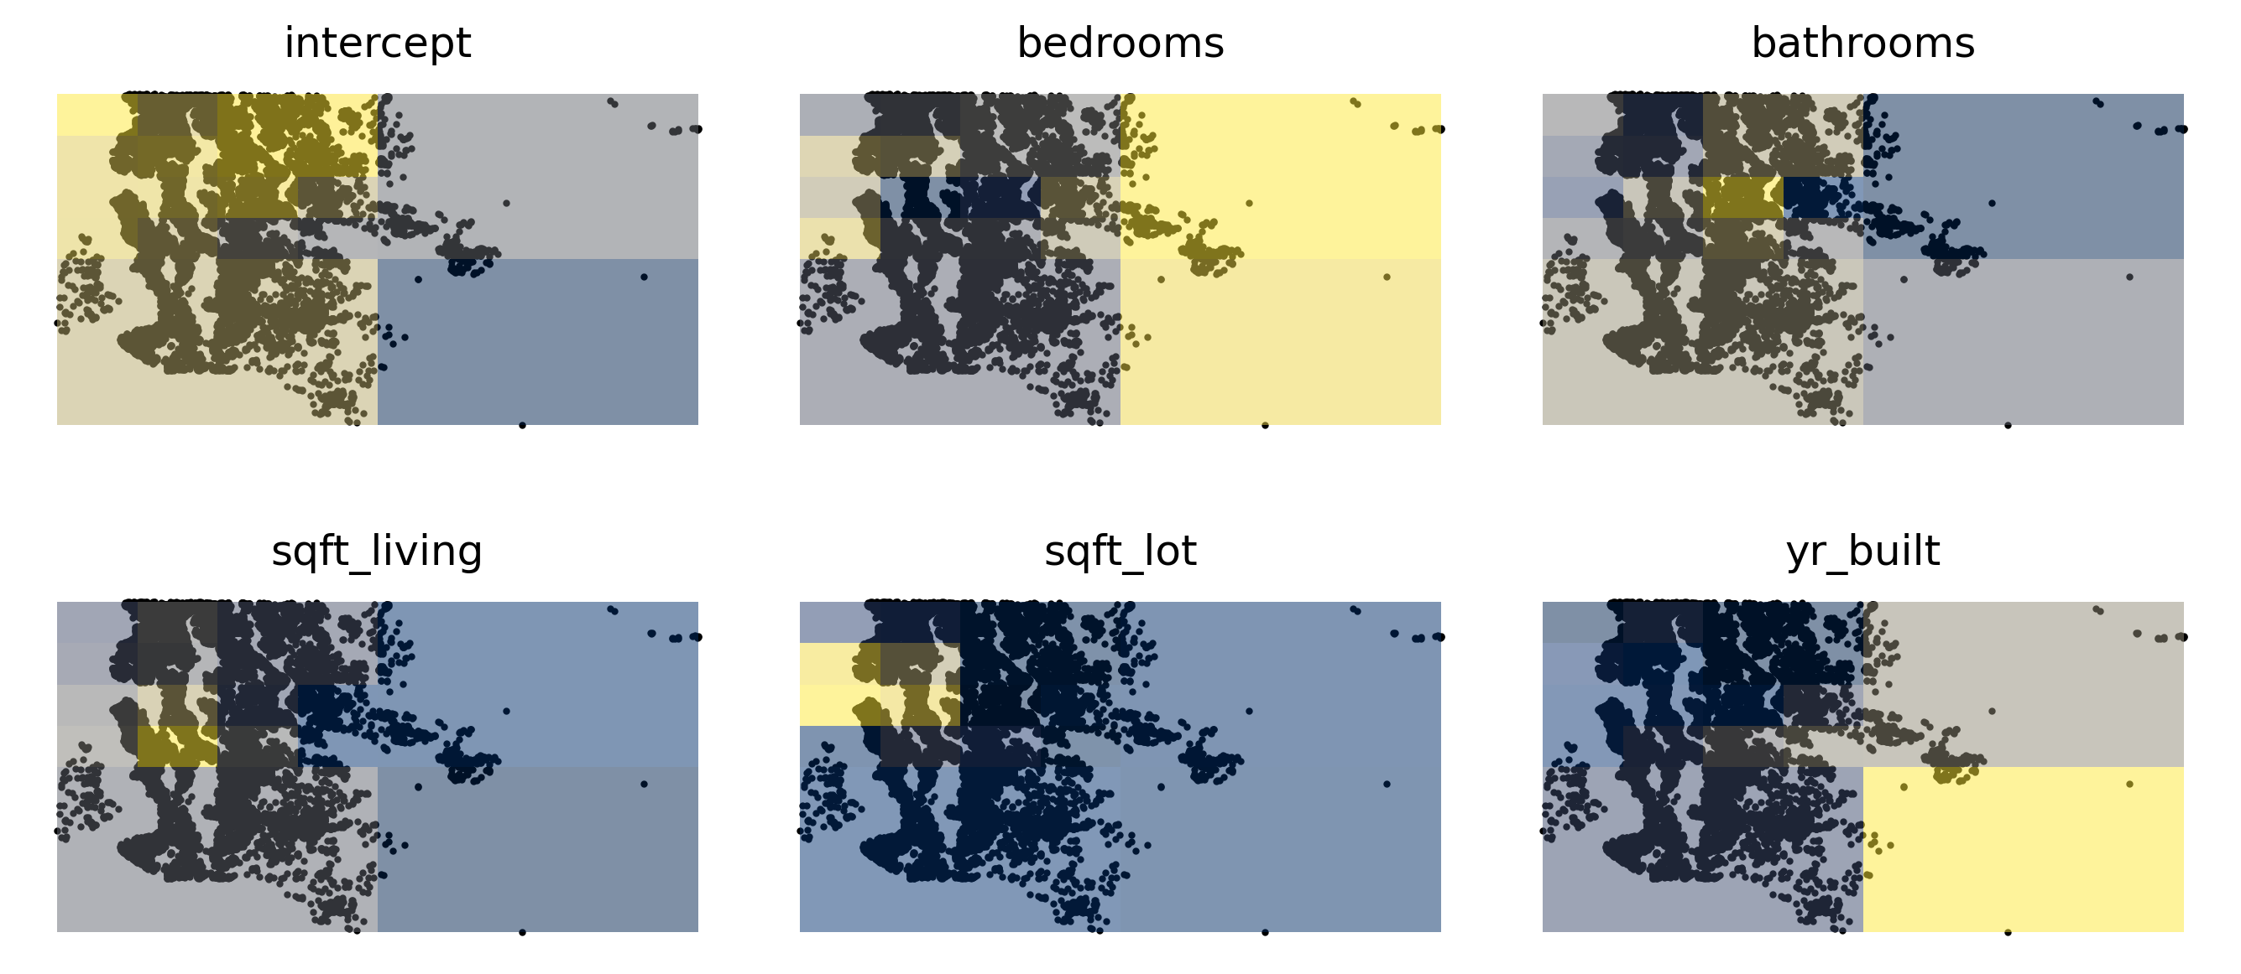
COEFFICIENT SURFACES LOOK LIKE THIS

Slide 50
Prices in general are expensive towards the coast, also in the start-upish areas in the north east.
COEFFICIENT SURFACES LOOK LIKE THIS

Slide 51
Space is at a premium, with living space slightly more expensive south-center.
COEFFICIENT SURFACES LOOK LIKE THIS

Slide 52
PLACE | METHOD | MSE | R² | TIME
Baltimore | OLS | .16 | .49 | Sub-seconds
n=211 | Skater 15 Regimes | .02 | .93 | Seconds
 | MGWR | .01 | .95 | Seconds
 | SuperQT (no prune) | .04 (.02) | .89 (.94) | Seconds
King’s Co. | OLS | .13 | .53 | Seconds
n=31k | Skater 15 Regimes | .05 | .811 | Hours
 | MGWR | DNF | DNF | DNF
 | SuperQT (no prune) | .06 (.06) | .78 (.78) | Minutes
COMPARISONS

Slide 53
PLACE | METHOD | MSE | R² | TIME
Baltimore | OLS | .16 | .49 | Sub-seconds
n=211 | Skater 15 Regimes | .02 | .93 | Seconds
 | MGWR | .01 | .95 | Seconds
 | SuperQT (no prune) | .04 (.02) | .89 (.94) | Seconds
King’s Co. | OLS | .13 | .53 | Seconds
n=31k | Skater 15 Regimes | .05 | .811 | Hours
 | MGWR | DNF | DNF | DNF
 | SuperQT (no prune) | .06 (.06) | .78 (.78) | Minutes
Small n: usually need eps+perm (lrt+wald dof issues)
Big n: both lrt+wald and eps+perm are useful
COMPARISONS

Slide 54
PLACE | METHOD | MSE | R² | TIME
Baltimore | OLS | .16 | .49 | Sub-seconds
n=211 | Skater 15 Regimes | .02 | .93 | Seconds
 | MGWR | .01 | .95 | Seconds
 | SuperQT (no prune) | .04 (.02) | .89 (.94) | Seconds
King’s Co. | OLS | .13 | .53 | Seconds
n=31k | Skater 15 Regimes | .05 | .811 | Hours
 | MGWR | DNF | DNF | DNF
 | SuperQT (no prune) | .06 (.06) | .78 (.78) | Minutes
COMPETITIVE EVEN AFTER PRUNING

Slide 55
PLACE | METHOD | MSE | R² | TIME
Baltimore | OLS | .16 | .49 | Seconds
n=211 | Skater 15 Regimes | .02 | .93 | Seconds
 | MGWR | .01 | .95 | Seconds
 | SuperQT (no prune) | .04 (.02) | .89 (.94) | Seconds
King’s Co. | OLS | .13 | .53 | Seconds
n=31k | Skater 15 Regimes | .05 | .811 | Hours
 | MGWR | DNF | DNF | DNF
 | SuperQT (no prune) | .06 (.06) | .78 (.78) | Minute
Pruning is especially powerful in big data:
~90 feature x leaf interactions in Skater & SuperQT
~60 post pruning w/ very small change to fit (for both)
COMPETITIVE EVEN AFTER PRUNING

Slide 56
MIT-Licensed
High performance w/ scipy.sparse
Available in PySAL by December 2023
THE SUPERVISED QUADTREE, IMPLEMENTED

Slide 57
SUPERVISED QUADTREES:
a new metalearner for
local data science
LEVI JOHN WOLF
levi.john.wolf@bristol.ac.uk

